Slide 1
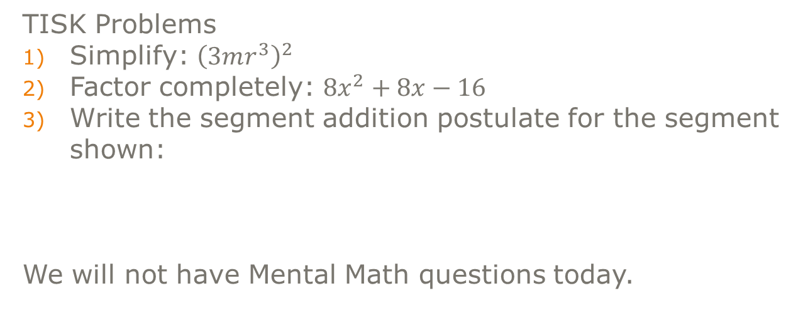
Wednesday, September 5, 2012
TISK Problems
Simplify: ${\left(3mr^{3}\right)}^{2}$
Factor completely: $8x^{2}+8x−16$
Write the segment addition postulate for the segment shown:
We will not have Mental Math questions today.
B U T
Homework: p. 128
#16-33 mentally;
34-43 writing
Notes:
Mental Math:
1)

Slide 2
§3.1 Parallel Lines & Transversals
Parallel lines
Two lines are parallel if and only if they are coplanar and never intersect.
Skew Lines
Two lines are skew if and only if they are NOT coplanar and never intersect
Parallel planes
Two planes are parallel if and only if they never intersect

Slide 3
Name…
All pairs of parallel planes.
All pairs of skew lines.
E
F
B
D
A
C

Slide 4
More Definitions
Transversals
A line that intersects two or more coplanar lines
Corresponding Angles
Two angles that occupy corresponding positions
Alternate Exterior Angles
Two angles that lie outside the two lines on opposite sides of a transversal
Alternate Interior Angles
Two angles that lie between the two lines on opposite sides of a transversal
Consecutive Interior Angles
Two angles that lie between the two lines on the same side of a transversal (Also called: Same Side Interior Angles)

Slide 5
What does all that mean?
Alternate Interior Angles
Alternate Exterior Angles
Corresponding angles
Consecutive Interior (or Same Side Interior) Angles
transversal

Slide 6
Check Points
List all pairs of angles that fit the description.
Corresponding
Alternate exterior
Alternate interior
Consecutive interior
2
1
4
3
6
8
5
7

Slide 7









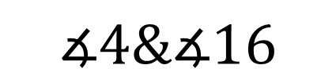


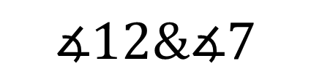






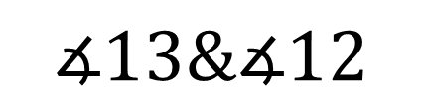



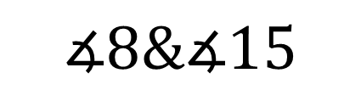






Practice
State the transversal that forms each pair of angles. Then identify the special name for the angle pair.
$$∡13\&∡12$$
$$∡12\&∡7$$
$$∡8\&∡15$$
$$∡8\&∡3$$
$$∡4\&∡16$$
$$1$$
$$3$$
Transversal: $𝓃$
Transversal:$none$
Transversal:$𝓂$
Transversal:$p$
Transversal:$ℓ$
$$2$$
$$4$$
$$14$$
$$15$$
Consecutive Interior
Alternate Interior
No relationship
Alternate Exterior
Corresponding
$$13$$
$$16$$
$$ℓ$$
$$5$$
$$6$$
$$12$$
$$11$$
$$𝓂$$
$$7$$
$$9$$
$$8$$
$$10$$
$$p$$
$$𝓃$$
Notes:
$∡13 \&∡12$ transversal:$𝓃$ relationship: consecutive interior
$∡4 \&∡16$ transversal: $ℓ$ relationship: consecutive interior
$∡8 \&∡3$ transversal:$p$ relationship: alternate exterior
$∡12 \&∡7$ transversal:$𝓂$ relationship: alternate interior
$∡8 \&∡15$ transversal: $none$ relationship: no relationship

Slide 8
Homework
Homework: p. 128
#16-33 mentally;
34-43 writing

